Slide 1

Overview of Financial System
Financial Management(HS4L003)
Dr. Naresh Chandra Sahu
Associate Professor (Economics)
School of Humanities, Social Sciences & Management
Indian Institute of Technology, Bhubaneswar

Slide 2

Learning Outcomes
Understand the concept and role of the financial system
Identify different financial institutions (banks, NBFCs, DFIs, etc.)
Learn about financial markets – money, capital, debt, and forex
Know various financial instruments (T-bills, bonds, CDs, etc.)
Understand financial services like banking, insurance, and investments
Learn how the money market operates with short-term instruments
Understand the structure of the debt and capital markets
Explore the workings of the forex market and its types
Recognize the role of regulatory institutions in the financial system

Slide 3
Financial System
A financial system is a network of institutions, markets, instruments, and services that facilitate the flow of funds between savers (those who have surplus funds) and borrowers (those who need funds).
Objectives of a Financial System:
Efficient Fund Allocation – Channel savings into productive investments
Capital Formation – Helps in building the capital stock of the economy
Liquidity Provision – Ensure that money is available when and where it is needed
Information Processing – Help in assessing risk and return through credit rating and analysis
Financial Inclusion – Ensure access to financial services for all, especially the underserved

Slide 4
Financial Institutions
Financial Services
Financial System
Financial Instruments
Financial Market

Slide 5
Financial Institution
A financial institution is an organization that provides financial services to individuals, businesses, and governments. These services include deposit-taking, lending, investment, insurance, and financial market facilitation.
Banking Institutions
Non-Banking Institutions
Mutual Fund
Insurance Companies
Housing Finance Companies
Regulatory Institutions

Slide 6
Banking Institutions
A banking institution is a type of financial institution that is legally allowed to accept deposits from the public and create credit.
Scheduled Commercial Bank
Non-Scheduled Commercial Bank
Included in the Second Schedule of the RBI Act, 1934
Must have a minimum ₹5 lakh in paid-up capital
Can borrow from RBI for funds and emergencies
SBI, HDFC, ICICI, Bank of Baroda, Axis Bank, PNB
Full range: loans, deposits, ATMs, net banking, cards, etc.
Not included in the Second Schedule of the RBI Act, 1934
No fixed requirement; often less than ₹5 lakh
No direct access to RBI lending facilities
Some local cooperative banks, small rural or community banks
Limited services, often only basic deposit and loans

Slide 7
Non Banking Institutions
Financial services similar to banks, but that do not hold a banking license, cannot accept demand deposits (like savings or current accounts).
Do not accept demand deposits (like savings/current accounts)
Provide loans, insurance, investments, and leasing services
Cannot issue cheques like banks
Examples: Bajaj Finance, LIC, HDFC Mutual Fund
NBFC
Provide long-term finance for development projects
Support industry, agriculture, SMEs, and infrastructure
Often government-backed
Do not accept public deposits
Examples: SIDBI, NABARD, EXIM Bank, IFCI
Development Financial Institutions

Slide 8
Mutual Fund
A mutual fund is a type of investment vehicle that pools money from many investors to invest in a diversified portfolio of assets such as:
Stocks
Bonds
Money market instruments
Other securities
How Does It Work?
Pooling of Money: Investors contribute money to the fund.
Investment by Fund Manager: The manager invests this pool based on the fund's objectives.
Returns & NAV: Returns (profits or losses) are reflected in the Net Asset Value (NAV)—the per-unit price of the fund.
Redemption: Investors can sell (redeem) their mutual fund units at the current NAV.

Slide 9
Mutual Fund
Types of Mutual Funds:
Based on assets and class: Equity Funds, Debt Funds, Hybrid Funds, Money Market Funds
Based on structure: Open-ended funds, Closed-end funds, and Interval funds
Based on objectives: Growth funds, Income funds, Tax saving funds, Index funds, Sectoral/thematic funds.

Slide 10
Mutual Fund
Benefits of Mutual Funds
Diversification: Spreads risk across many assets.
Professional Management: Handled by experts.
Liquidity: Easy to buy/sell (open-ended).
Transparency: Regular updates on holdings and performance.
Accessibility: Start with small amounts (e.g., SIPs).
Regulated: In most countries, mutual funds are regulated (e.g., by SEBI in India, SEC in the U.S.).

Slide 11
Mutual Fund
Risks Involved:
Market Risk: Value can go down with markets.
Interest Rate Risk: Affects debt funds.
Credit Risk: Bonds in the fund may default.
Liquidity Risk: Some funds may be hard to sell quickly.
Fund Manager Risk: Poor decisions can affect returns.

Slide 12
Insurance Companies
An insurance company is a financial institution that offers risk coverage by collecting premiums and providing payouts or benefits in case of insured events.
Types of Insurance Companies:
Life Insurance Companies
Covers life risk (death, survival, etc.)
Example: LIC (Life Insurance Corporation of India)
General Insurance Companies
Covers non-life risks (car, health, fire, travel, etc.)
Example: New India Assurance, ICICI Lombard
Health Insurance Companies
Focuses only on medical expenses
Example: Star Health Insurance

Slide 13
Housing Finance Companies
Housing Finance Companies (HFCs) are non-banking financial institutions that provide home loans to individuals or builders for:
Specialize in home-related financing
Offer EMIs (monthly repayment system)
Usually have fixed or floating interest rates
Require property as collateral
Faster processing than banks (in some cases)

Slide 14
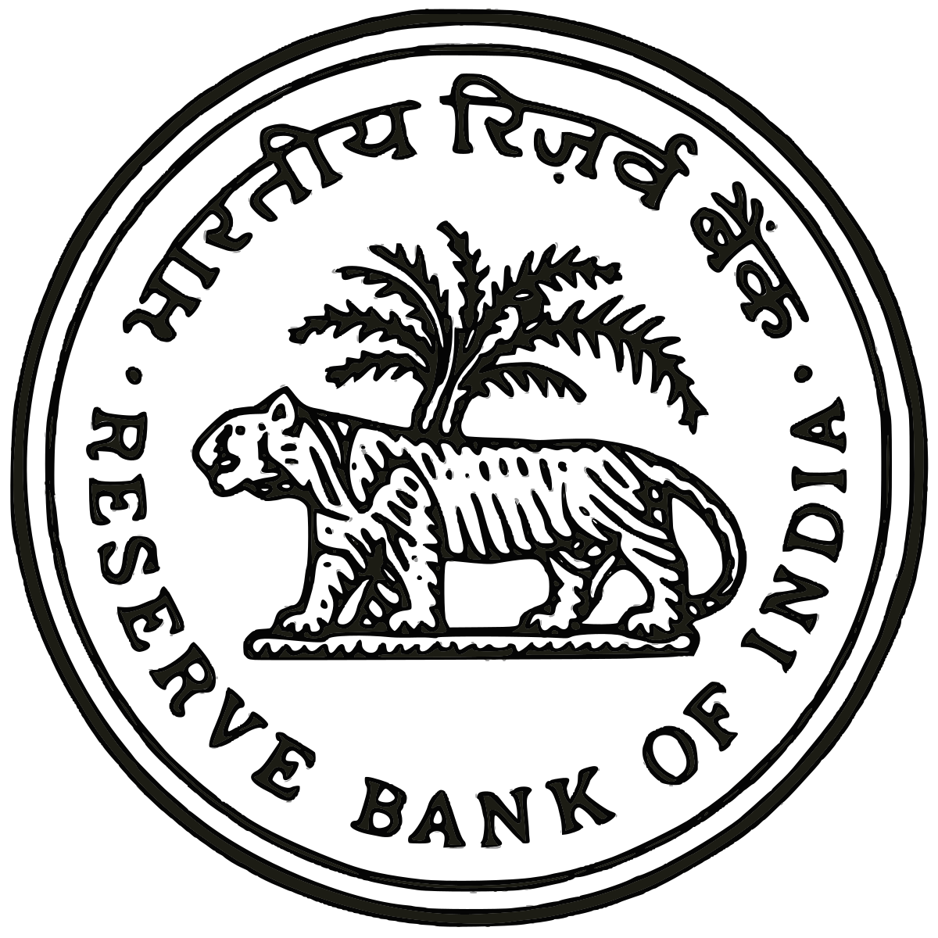

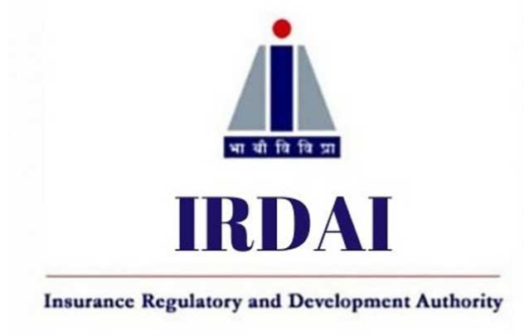

Regulatory Institutions
Regulatory institutions are government or statutory bodies that monitor, control, and guide financial, economic, and business activities to ensure stability, fairness, and transparency in the system.
Reserve Bank of India
Securities and Exchange Board of India
Insurance Regulatory and Development Authority of India
Pension Fund Regulatory Development Authority of India

Slide 15
Financial Services
Financial services are the functions and facilities provided by financial institutions to manage money and facilitate transactions.
Banking Services – Deposits, loans, credit cards (e.g., SBI, HDFC)
Investment Services – Mutual funds, stockbroking (e.g., Groww, Zerodha)
Insurance Services – Life, health, general insurance (e.g., LIC, Star Health)
Capital Market Services – IPOs, bonds, equity raising
Leasing & Hire Purchase – Use of assets without buying (e.g., vehicle leasing)
Forex Services – Currency exchange, remittance (e.g., Western Union)
Fintech Services – Digital payments, UPI, mobile banking (e.g., Paytm, PhonePe)

Slide 16
Financial Market
A market is an arrangement where buyers and sellers come together to exchange goods or services, or to trade financial instruments/products, at a particular time and place.
Financial Market
Money Market
Debt Market
Forex Market
Capital Market

Slide 17
Money Market
The money market is a part of the financial market where short-term borrowing and lending take place – usually for less than one year.
Treasury Bills (T-Bills)
Issued by: Government of India
Maturity: 91 days, 182 days, or 364 days
Purpose: The Government raises short-term funds
Example: RBI issues a 91-day T-bill at ₹97 for a face value of ₹100
Commercial Paper (CP)
Issued by: Large corporations
Maturity: 15 days to 1 year
Purpose: Short-term working capital needs
Example: Tata Motors issues CP to raise ₹100 crores for 6 months

Slide 18
Money Market
Certificate of Deposit (CD)
Issued by: Commercial banks
Maturity: 7 days to 1 year (for individuals), up to 3 years (for institutions)
Purpose: Raise funds from the public
Example: SBI issues a CD offering 6% interest for 6 months
Call Money / Notice Money
Call Money: Overnight funds (1 day)
Notice Money: 2–14 days
Participants: Banks and financial institutions
Example: HDFC Bank borrows ₹500 crores from ICICI Bank for 1 day at 4% interest

Slide 19
Money Market
Repurchase Agreements (Repo)
Short-term loans backed by securities(within or equal to one year)
One party sells securities with an agreement to repurchase them later
Example: RBI conducts a repo operation to inject liquidity in the system
Banker’s Acceptance (BA)
A time draft (post-dated cheque) guaranteed by a bank
Common in foreign trade transactions
Example: An Indian exporter receives a BA from a US buyer’s bank for payment after 60 days

Slide 20
Debt Market
The debt market is a financial market where investors buy and sell debt securities. These are instruments where the borrower promises to repay the principal with interest after a fixed time.
Who are the Participants?
Government (Central, State)
Corporates
Banks
Mutual Funds
Insurance companies
Retail investors

Slide 21
Debt Market
Types of Debt Market
1. Government Securities (G-Secs) Market
Bonds issued by Central or State Governments
Considered risk-free
Example: RBI issues a 10-year Government bond at 7% interest
2. Corporate Debt Market
Bonds/debentures issued by companies to raise capital
Example: Reliance Industries issues Non-Convertible Debentures (NCDs)

Slide 22
Debt Market
3. Money Market (Short-term debt instruments)
Already covered earlier (T-Bills, CP, CD, etc.)
4. Municipal Bond Market
Bonds issued by local authorities/municipalities
Example: Pune Municipal Corporation issues bonds for water infrastructure

Slide 23
Forex Market
The FOREX market is a global marketplace where currencies are bought and sold. It is the largest and most liquid financial market in the world..
Who are the Participants?
Central Banks (e.g., RBI)
Commercial Banks
Corporations (importers/exporters)
Investors & Hedge Funds
Tourists & Travelers
Forex Brokers

Slide 24
Forex Market
Spot Market
In the spot market, currencies are exchanged immediately at the current exchange rate (called the "spot rate").
Settlement: Within 2 business days.
Example: You want to buy $1,000 today. If 1 USD = ₹83, you pay ₹83,000. The transaction is done on the spot.

Slide 25
Forex Market
Forward Market
A private agreement between two parties to buy/sell a currency at a fixed rate on a future date.
Settlement: On the agreed future date.
Example: A company expects to pay $1 million in 3 months. They lock in a rate of ₹84/USD with a bank to avoid future currency fluctuations.

Slide 26
Forex Market
Future Market
Similar to forwards, but standardized contracts are traded on organized exchanges (like NSE, BSE, CME).
Example: An investor buys a USD-INR futures contract on NSE that expires in 1 month. If the rate moves in their favor, they profit.
Difference from Forward:
Futures are regulated, standardized, and publicly traded.
Forwards are private and customizable.

Slide 27
Forex Market
Option Market
A contract that gives the buyer the right (but not obligation) to buy or sell a currency at a fixed rate before a set date.
Example: You buy an option to buy USD at ₹85 anytime in the next 2 months. If USD rises to ₹90, you exercise the option and profit. If it falls to ₹80, you let the option expire and lose only the premium.

Slide 28
Capital Market
The Capital Market is a part of the financial system where long-term funds are raised and invested through the buying and selling of securities, such as shares, bonds, debentures, etc.
Who are the Participants?
Companies (issuers of securities)
Investors (individuals, institutions)
Stock Exchanges (NSE, BSE)
Regulators (like SEBI in India)

Slide 29
Capital Market
Types of Capital Market;
Primary Market (New Issue Market)
Where new securities are issued for the first time
Companies raise capital by issuing IPO (Initial Public Offering)
Example: Reliance Industries issues new shares to the public for the first time.
Secondary Market (Stock Market)
Where existing securities are bought and sold among investors
Provides liquidity to investments
Example: You buy Tata Motors shares from another investor on the NSE/BSE.

Slide 30
Question
What is financial inclusion, and why is it important in India?
Name two key regulatory bodies in the Indian financial system.
What does the Indian banking sector faces the major challenges today?

Slide 31

NAMASKAR
&
THANK YOU

